Slide 1
ADDER AND SUBTRACTOR USING VERILOG
Lab 2
By: ER Shiva Raj Luitel

Slide 2
Objective
To implement Half Adder circuit using Verilog..
To implement full adder circuit using Verilog..
To implement 4-bit adder/subtractor circuit using Verilog.

Slide 3
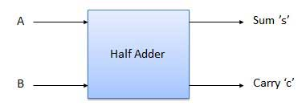
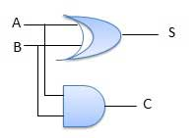
Theory
Half Adder

Slide 4
Verilog coding
module halfadder
(
input A,
input B,
output S,
output C
);
assign S=A^B;
assign C=A&B;
endmodule
Test fixture
Initial begin
A=0;
B=0;
#100;
A=0;
B=1;
#100;
…
$finish;
end

Slide 5
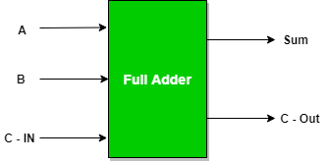
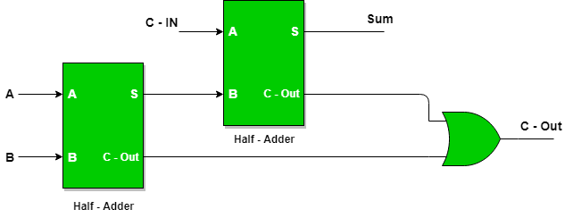
Full Adder

Slide 6
Verilog Code
module FULLADDER(
input A,
input B,
input Cin,
output S,
output Cout
);
wire S1 , C1 , C2;
halfadder ha1(A , B , S1 , C1);
halfadder ha2(S1 , Cin , S , C2);
or g1(Cout , C1 , C2);
endmodule
Test fixture By student

Slide 7
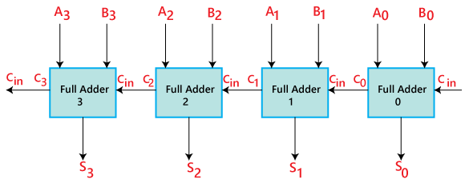
4-bit Adder ciruit

Slide 8
4-bit Adder code
module fourbitadder(
input [3:0] A,
input [3:0] B,
input Cin,
output [3:0] S,
output Cout
);
wire C0 , C1 , C2;
FULLADDER fa1(A[0] , B[0] , Cin , S[0] , C0 );
FULLADDER fa2(A[1] , B[1] , C0 , S[1] , C1);
FULLADDER fa3(A[2] , B[2] , C1 , S[2] , C2);
FULLADDER fa4(A[3] , B[3] , C2 , S[3] , Cout);
endmodule

Slide 9
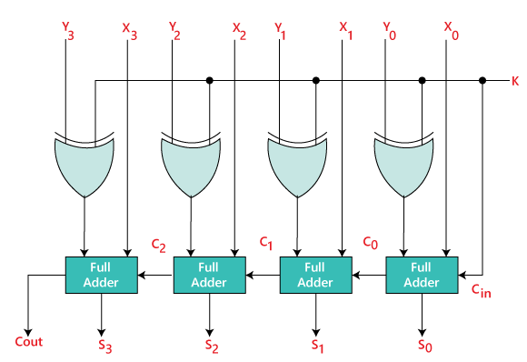
4-bit adder subtractor using Verilog

Slide 10
Code
module fourbitaddersub(
input [3:0] A,
input [3:0] B,
input M,
input Cin,
output [3:0] S,
output Cout
);
wire C0 , C1 , C2, B0,B1,B2,B3;
xor g0(B0, B[0],M);
xor g1(B1, B[1],M);
xor g2(B2, B[2],M);
xor g3(B3, B[3],M);
FULLADDER fa1(A[0] , B0 , Cin , S[0] , C0 );
FULLADDER fa2(A[1] , B1 , C0 , S[1] , C1);
FULLADDER fa3(A[2] , B2 , C1 , S[2] , C2);
FULLADDER fa4(A[3] , B3 , C2 , S[3] , Cout);
endmodule

Slide 11
Observation
RTL and timing diagram

Slide 12
Discussion and conclusion

